Slide 1
Low Leg Injuries
Anatomy

Slide 2
Introduction
Have you ever had shin splints?
Did you know that there is a medical term for shin splints?
Can you figure out what it might be called?
Where is the pain located?
What causes shin splints?
What muscles are involved?
What would you name shin splints?

Slide 3
Objectives
Review Low Leg anatomy
  Muscles
    Origin, Insertion and Action
  Bones
    Landmarks
Preview Low Leg Unit
  Injuries to Low Leg
  Tape Skills

Slide 4
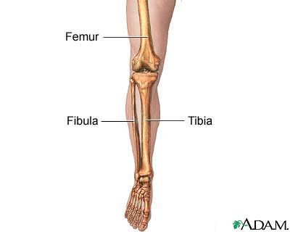
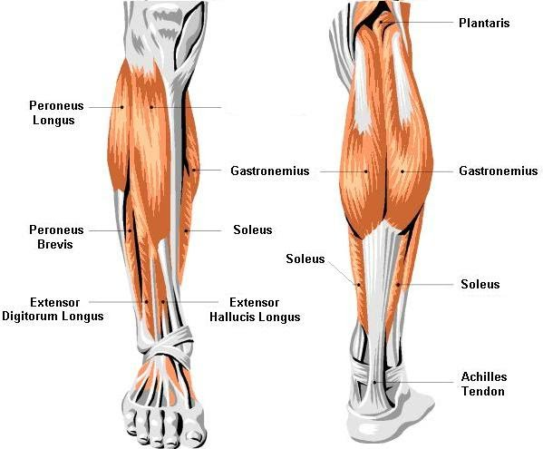
Anatomy
Muscles:
Gastroc
Soleus
Tibialis Anterior
Tibialis Posterior
Peronus Brevis
Peronus Longus
Achilles Tendon
Tibialis Anterior
Bones:
Tibia
Fibula
Femur
(Patella)

Slide 5
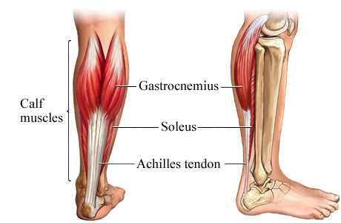
Achilles Tendon
Two Muscle Tendon
  Gastrocnemius
    Superficial
    O: Med & Lat condyles of femur
    I: Calcaneus
    A: Plantarflexion of foot
  Soleus
    Deep
    O: Posterior tibia & fibula
    I: Calcaneus
    Plantarflexion of foot

Slide 6
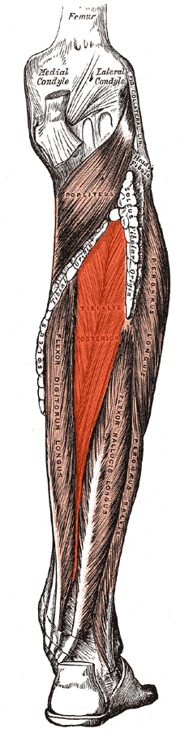
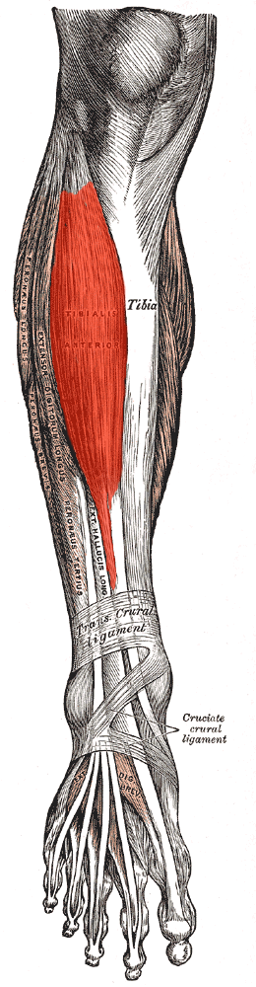
Tibialis Muscles
Tibialis Anterior
  O: Lat condyle of tibia
  I: Plantar surface of 1st Metatarsal
  A: Dorisflex & Invert foot
Tibialis Posterior
  O: Posterior tibia & fibula
  I: Plantar tarsals
  A: Plantarflex & Invert foot

Slide 7
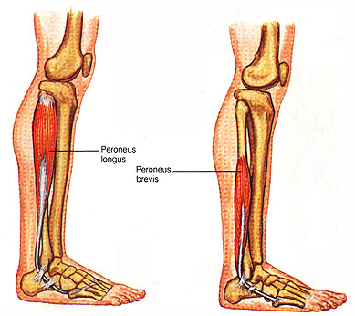
Peroneus Muscles
Peroneus Longus
  (Superficial)
  O: Lateral proximal fibula
  I: Plantar 1st Metatarsal
  A: Plantarflex & eversion
Peroneus Brevis
  (Deep)
  O: Lateral low fibula
  I: Base of 5th MT
  A: Plantarflex & eversion

Slide 8
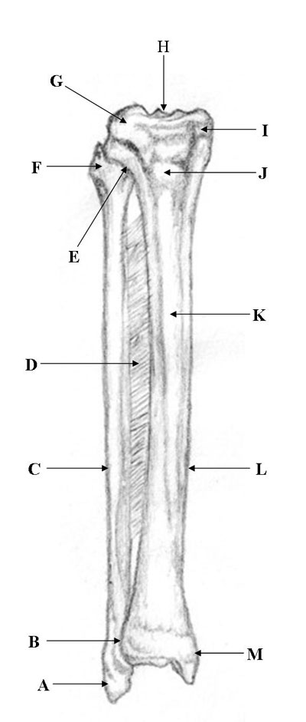
Bony Landmarks
A: Lateral Malleolus
B: Distal Tibiofibular Jt
C: Fibula (Shaft)
D: Interosseus Membrane
E: Proximal Tibiofibular Jt
F: Fibular Head
G: Lateral Condyle
H: Intercondylar Notch
I: Medial Condyle
J: Tibial Tuberosity
K: Anterior Crest
L: Tibia (Shaft)
M: Medial Malleolus
Items in bold: New Information

Slide 9
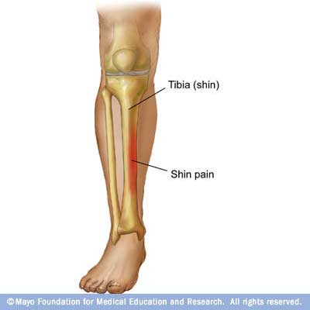
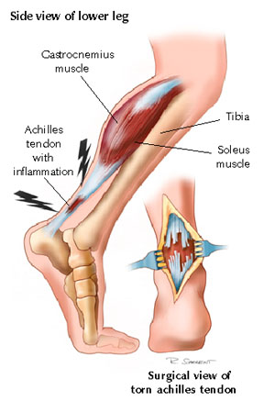
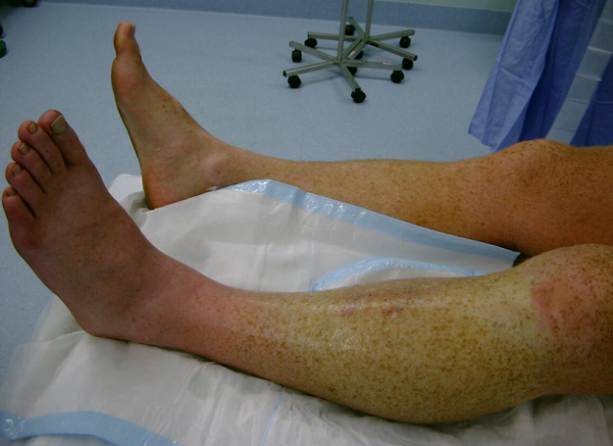
Low Leg Injuries
Medial
Tibial
Stress
Syndrome
Anterior Compartment Syndrome

Slide 10
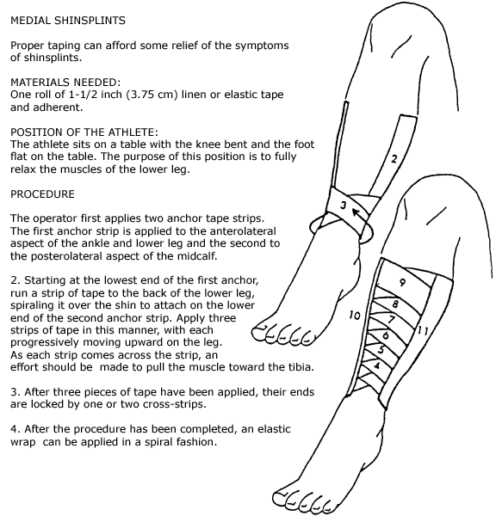
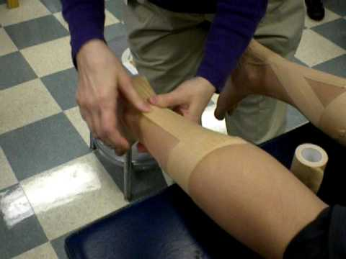
Tape jobs
Achilles Tendon Tape Support
MTSS (Shin splint) Tape support
MTSS Support
Achilles Support

